Slide 1

Orienteering Merit Badge
Troop 344 and 9344
Pemberville, OH

Slide 2

Orienteering Merit Badge Requirements
Show that you know first aid for the types of injuries that could occur while orienteering, including cuts, scratches, blisters, snakebite, insect stings, tick bites, heat and cold reactions (sunburn, heatstroke, heat exhaustion, hypothermia), and dehydration. Explain to your counselor why you should be able to identify poisonous plants and poisonous animals that are found in your area.
Explain what orienteering is.
Do the following:
  Explain how a compass works. Describe the features of an orienteering compass.
  In the field, show how to take a compass bearing and follow it.

Slide 3

Orienteering Merit Badge Requirements
Do the following:
  Explain how a topographic map shows terrain features. Point out and name five terrain features on a map and in the field.
  Point out and name 10 symbols on a topographic map.
  Explain the meaning of declination. Tell why you must consider declination when using map and compass together.
  Show a topographic map with magnetic north-south lines.
  Show how to measure distances using an orienteering compass.
  Show how to orient a map using a compass.
Set up a 100-meter pace course. Determine your walking and running pace for 100 meters. Tell why it is important to pace-count.

Slide 4
Orienteering Merit Badge Requirements
Do the following:
  Identify 20 international control description symbols. Tell the meaning of each symbol.
  Show a control description sheet and explain the information provided.
  Explain the following terms and tell when you would use them: attack point, collecting feature, catching feature, aiming off, contouring, reading ahead, handrail, relocation, rough versus fine orienteering.
Do the following:
  Take part in three orienteering events. One of these must be a cross-country course.
  After each event, write a report with:
    a copy of the master map and control description sheet ,
    a copy of the route you took on the course,
    a discussion of how you could improve your time between control points, and
    a list of your major weaknesses on this course . Describe what you could do to improve.

Slide 5
Orienteering Merit Badge Requirements
Do ONE of the following:
  Set up a cross-country course of at least 2,000 meters long with at least five control markers. Prepare the master map and control description sheet.
  Set up a score-orienteering course with 12 control points and a time limit of at least 60 minutes. Prepare the master map and control description sheet.
Act as an official during an orienteering even. This may be during the running of the course you set up for requirement 8.
Teach orienteering techniques to your patrol, troop or crew.

Slide 6

Requirement 1
Show that you know first aid for the types of injuries that could occur while orienteering, including cuts, scratches, blisters, snakebite, insect stings, tick bites, heat and cold reactions (sunburn, heatstroke, heat exhaustion, hypothermia), and dehydration. Explain to your counselor why you should be able to identify poisonous plants and poisonous animals that are found in your area.

Slide 7
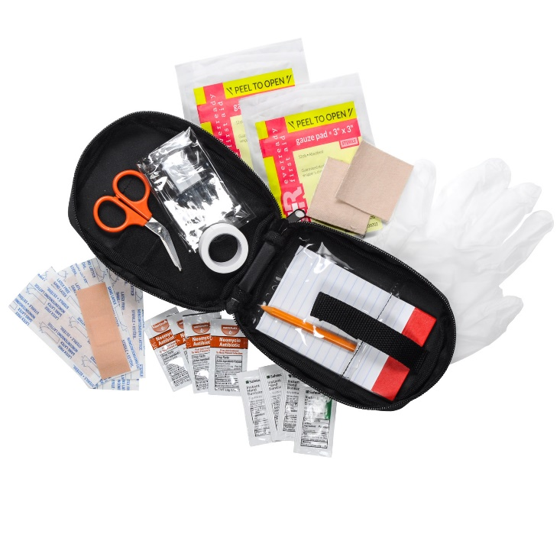
Personal First-Aid Kit
The items you carry in your personal first-aid kit will handle most of the medical problems you are likely to encounter while orienteering.
Adhesive bandages (6)
Sterile gauze pads, 3”x3” (2)
Adhesive tape (1 small roll)
Moleskin, 3”x6” (1)
Hand sanitizing gel (1 travel size bottle)
Triple antibiotic ointment (1 small tube)
Scissors
Nonlatex disposable gloves (1 pair)
Mouth barrier device
Pencil and paper

Slide 8
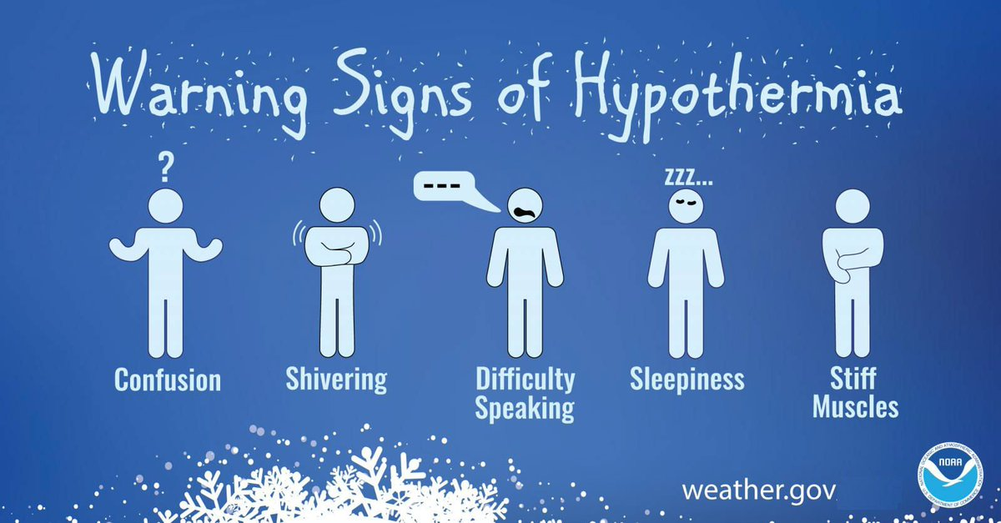
Hypothermia
Occurs when body cannot make heat as fast as it loses it.
Internal body temperature drops below 95ºF.
Can occur whenever and wherever a person feels cold, including indoors in poorly heated areas.

Slide 9
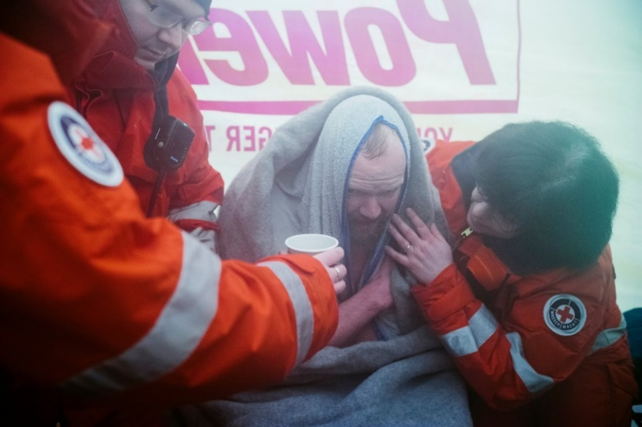
Hypothermia
Move victim to shelter.
Remove wet clothing and wrap victim in warm covers.
Apply direct body heat.
Re-warm neck, chest, abdomen, and groin first.
Give warm, sweet drinks if conscious.
Monitor breathing, administer CPR.
Get medical help.

Slide 10
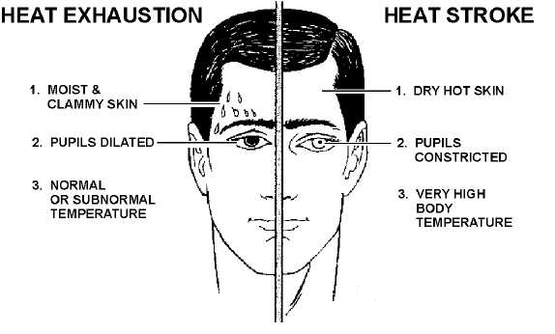
Heat Reactions

Slide 11
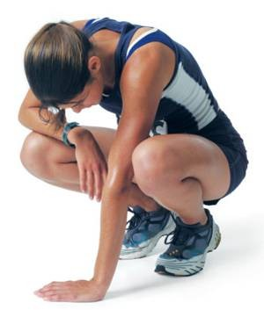
Heat Exhaustion Symptoms
Heavy sweating
Thirst
Fatigue
Heat cramps
Headache
Dizziness
Nausea
Vomiting

Slide 12
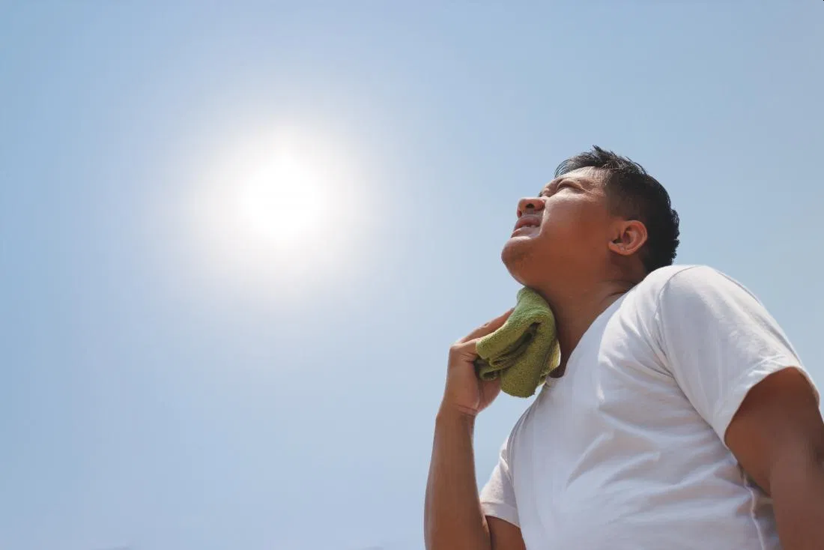
First Aid for Heat Exhaustion
Move victim from heat to rest in a cool place.
Loosen or remove unnecessary clothing.
Give water or a sports drink.
Raise feet 8-12 inches.
Put cool, wet cloths on forehead and body – spray skin with water.
Seek medical care if victim’s condition worsens or does not improve within 30 minutes.

Slide 13
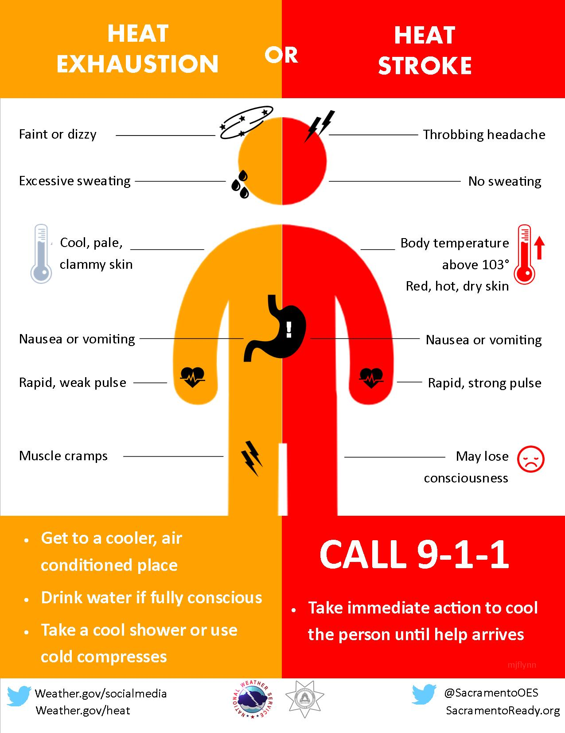
Heatstroke

Slide 14
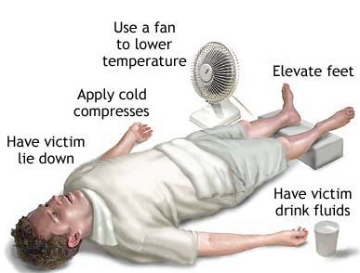
First Aid for Heat Stroke
Call 911.
Move victim to cool place.
Remove outer clothing.
Cool victim quickly.
Apply cold compresses or spray skin with water.
Put ice bags or cold packs beside neck, armpits, and groin.

Slide 15

Dehydration
When the body puts out more liquid than it is taking in.
Ways we lose fluids:
  Sweating.
  Urination.
  Vomiting.
Signs of dehydration:
  Thirst.
  Yellow or dark urine.
  Dry mouth.
  Lightheadedness.
  Nausea and vomiting.
  Dry skin.
  Cease sweating.
Treatment:
  Drink fluids (water, Gatorade).
  Avoid physical activity.
  Get inside air conditioned or cool area.

Slide 16
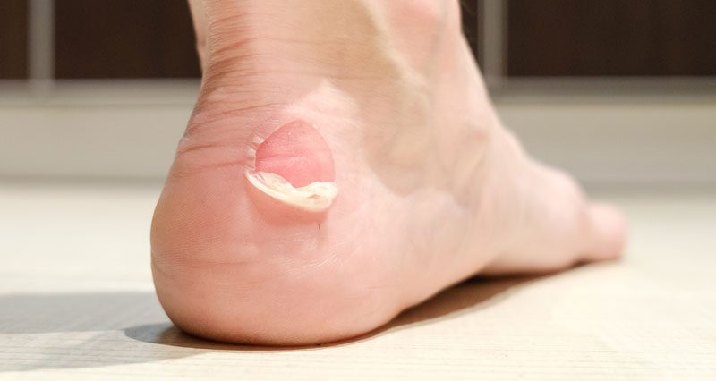
Blisters
A blister is skin injury that is usually filled with water.
Blisters commonly occur on the feet or hands.
They are most often caused by the hands or feet rubbing against something (such as wearing new shoes).

Slide 17
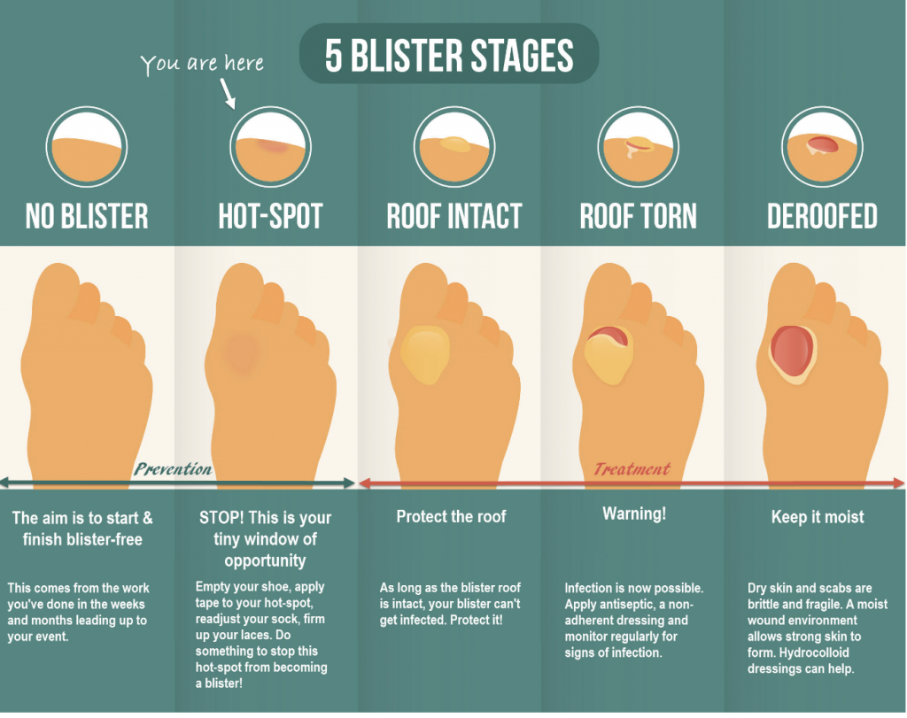

Slide 18
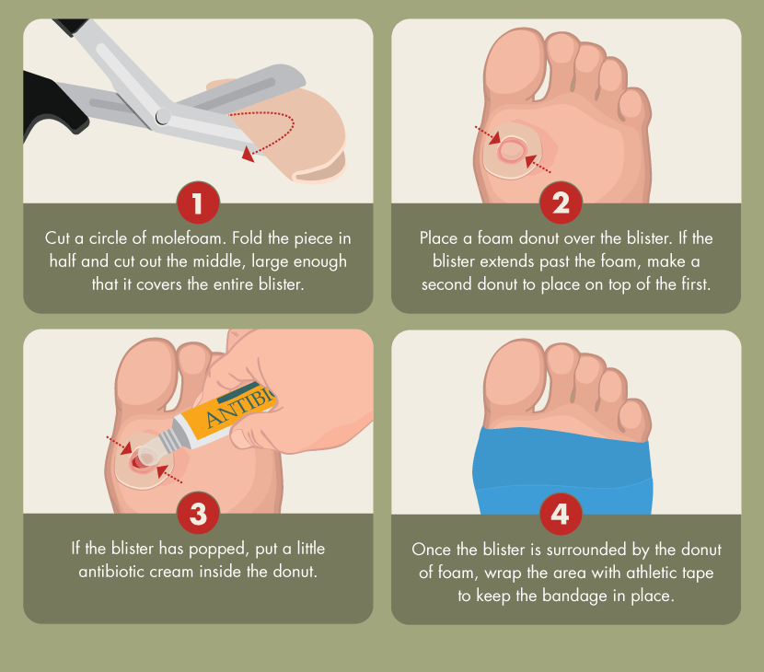
Treatment for Blisters
Do not open the blisters, since this increases the possibility of infection.
Clean the skin around it.
Take the pressure off the area by placing a Band-Aid over the blister or Moleskin with a hole cut in the center.
If the blister accidentally breaks open, trim off the loose skin.
Keep the surface clean by washing it twice a day with an antibacterial soap (such as Dial or Safeguard).
Apply an antibiotic ointment and a Band-Aid to help with healing.

Slide 19
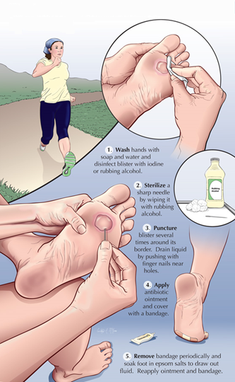
Popping a Blister
If a blister is in a frequently used area that has a high risk of rupturing, it may be best to pop it to make sure it’s properly protected against infection.
Wash your hands and the blister thoroughly.
Disinfect a needle with alcohol.
Carefully puncture the blister.
  Poke three or four shallow holes around the edge of the blister.
  You want to keep as much of the skin intact as possible.
  Allow the fluid to drain out.
Cover the blister with a first aid ointment such as Neosporin.
Apply a dressing.
  Cover the blister tightly with a bandage or gauze.
Repeat if necessary.
  You may need to perform these steps every six to eight hours for the first 24 hours.
  After that, change the dressing and apply ointment daily.

Slide 20
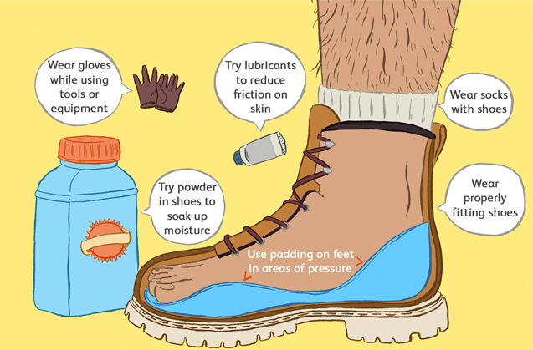
Preventing Blisters
Friction can also be reduced by wearing two pairs of socks.
Place Moleskin on sensitive areas were the friction may occur.

Slide 21
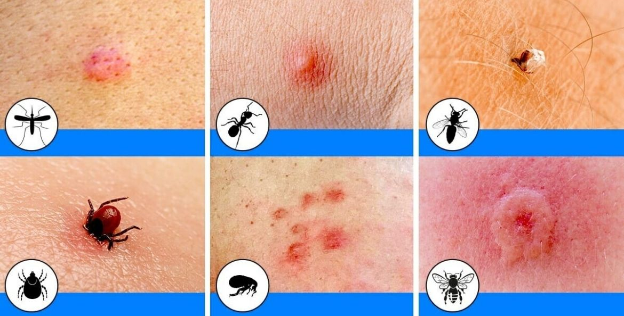
Insect Bites
Bites of mosquitoes and chiggers (harvest mites usually cause itchy, red bumps. The size of the swelling can vary from a dot to a half inch.
Signs that a bite is from a mosquito are: itchiness, a central raised dot in the swelling, a bite on skin not covered by clothing, and summertime,
Bites from horseflies, deerflies, gnats, fire ants, harvester ants, blister beetles, and centipedes usually cause a painful, red bump.
Fire ant bites change to blisters or pimples within a few hours.

Slide 22

Treatment of Insect Bites
Apply calamine lotion or a baking soda paste to the area of the bite.
If the itch is severe (as with chiggers), apply nonprescription 1% hydrocortisone cream four times a day.
Do not to pick at the bites or they can become infected or leave scars.
Cold, moist compresses or ice on the area can help.

Slide 23
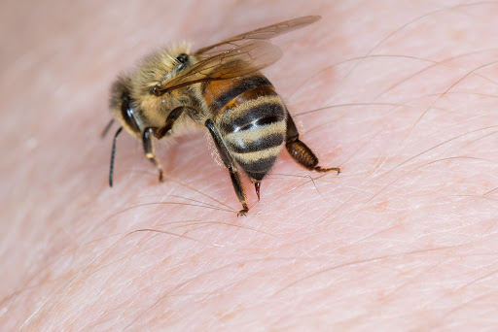
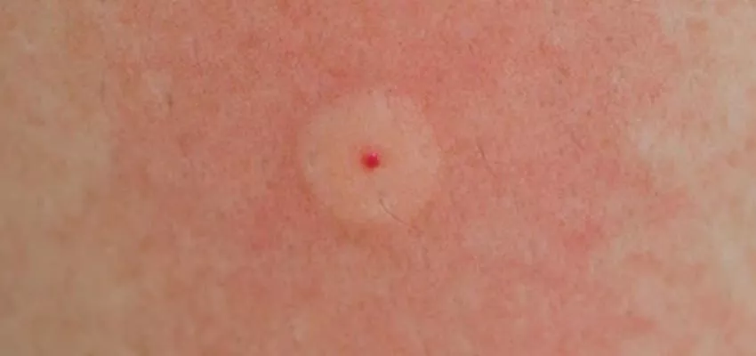
Bee Stings
Honey bees, bumble bees, hornets, wasps, and yellow jackets can all sting.
These stings cause immediate painful red bumps.
While the pain is usually better in 2 hours, the swelling may increase for up to 24 hours.

Slide 24
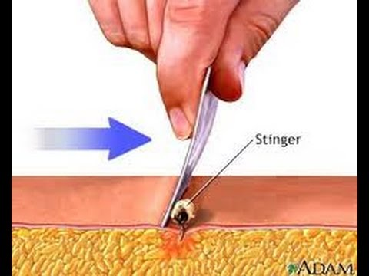
Treatment of Bee Stings
If you see a little black dot in the bite, the stinger is still present (this only occurs with honey bee stings).
Remove it by scraping it off with a credit card or something similar.
For persistent pain, massage with an ice cube for 10 minutes.
Give acetaminophen immediately for relief of pain and burning.
For itching, apply hydrocortisone cream.

Slide 25
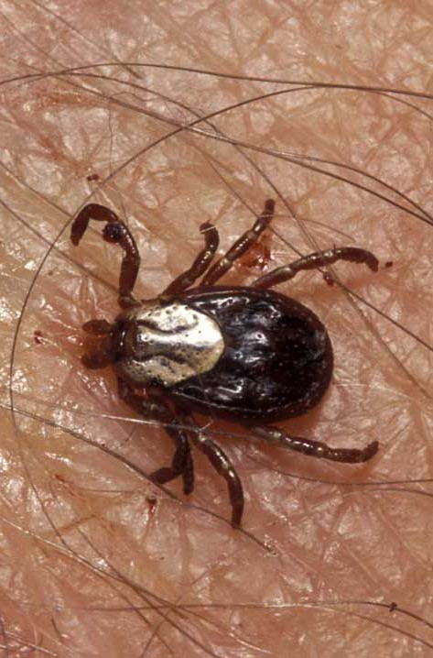
Tick Bites
Can transmit Rocky Mountain spotted fever or Lyme disease.
Tick embeds its mouth parts in skin and may remain for days sucking blood.

Slide 26
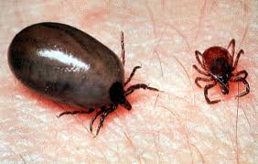
Engorged Tick

Slide 27
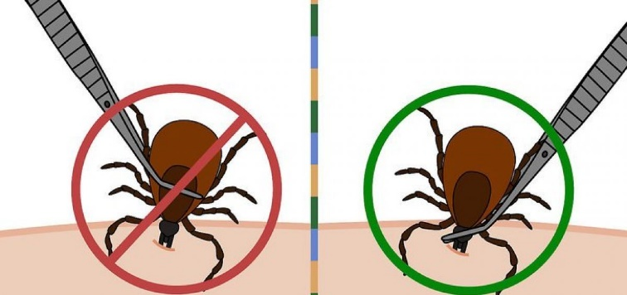
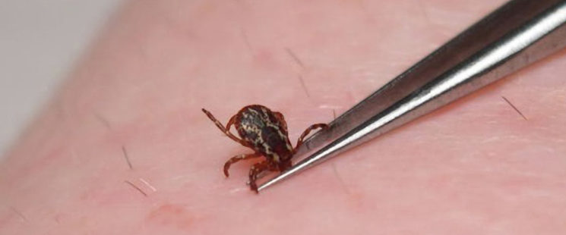
Tick Removal
Grasp the tick’s mouthparts against the skin, using pointed tweezers.
Pull steadily without twisting until you can ease the tick head straight out of the skin.
DO NOT squeeze or crush the body of the tick.
DO NOT apply substances such as petroleum jelly, nail polish, or a lighted match to the tick while it is attached.

Slide 28
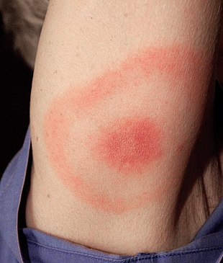
Tick Removal (cont.)
Once you have removed the tick, wash the wound site and your hands with soap and water, and apply rubbing alcohol or antiseptic to the site.
Observe the bite over the next two weeks for any signs of an expanding red rash or flu-like symptoms (Lyme Disease).
Lyme Disease Rash

Slide 29
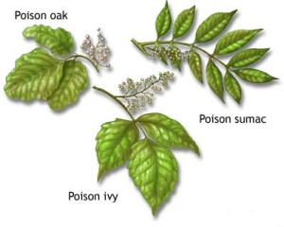
Poisonous Plants
Can you identify and name them in nature?

Slide 30
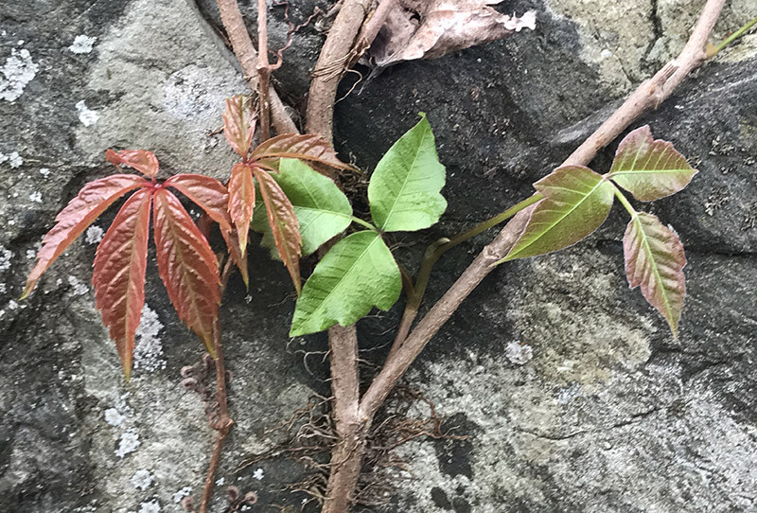
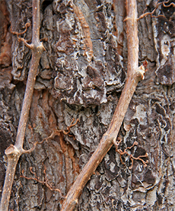
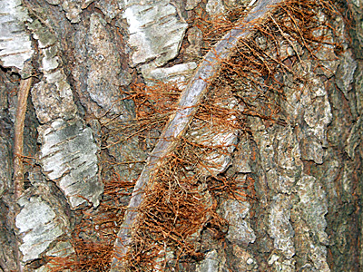
Identify Local Poisonous Plants
Virginia Creeper is sometimes mistaken for poison ivy.
The leaves and vines on the left are Virginia Creeper and those on the right are Poison Ivy.

Slide 31
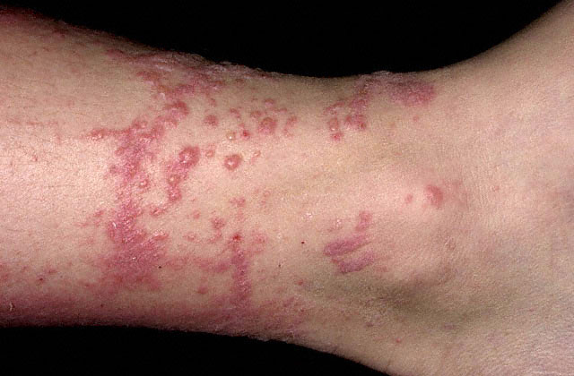
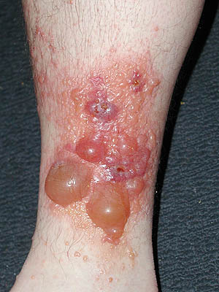
Poison Ivy Rash
Average Case
Severe Case

Slide 32
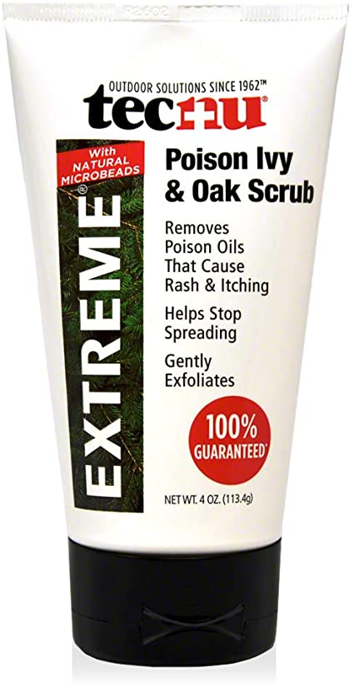
Treating Poison Ivy Exposures
If you are exposed you should quickly (within 10 minutes):
      Clean exposed areas with rubbing alcohol.
      Wash the exposed areas with water only first.
      Then take a shower with soap and warm water.
Tecnu is a poison oak and ivy scrub that removes urushiol.
Unfortunately, if you wait more than 10 minutes, the urushiol will likely stay on your skin and trigger the poison ivy rash.

Slide 33
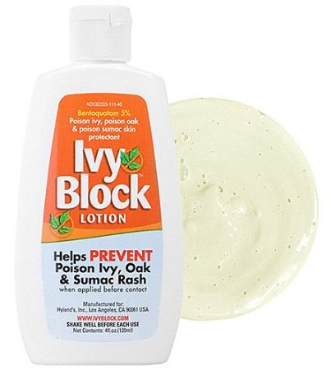
Preventing Poison Ivy
The best way to prevent Poison Ivy is learn to identify it and then avoid it!
You can avoid a poison ivy rash by:
  Wearing long pants and a shirt with long sleeves.
  Boots and gloves when your most at risk, especially when playing in wooden areas, around lakes, or going on hikes.
  Apply Ivy-Block to exposed skin.

Slide 34
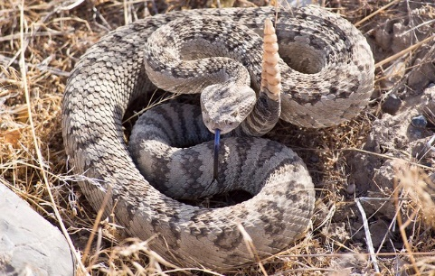
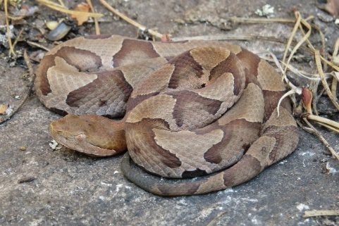
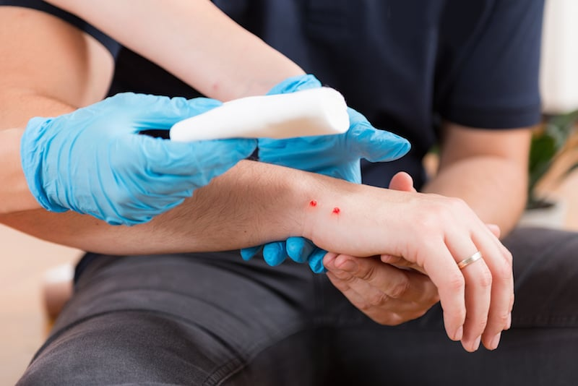
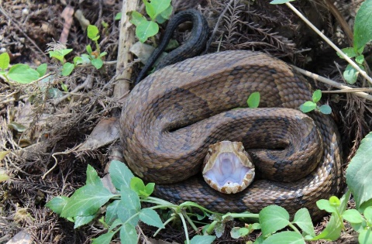
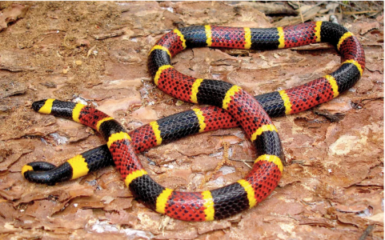
Poisonous Snakebite
In the U.S. the poisonous snakes are rattlesnakes, copperheads, cottonmouths, and coral snakes.
Currently about 8,000 people per year in the U.S. are bitten by a poisonous snake, of which about 6 will die.

Slide 35
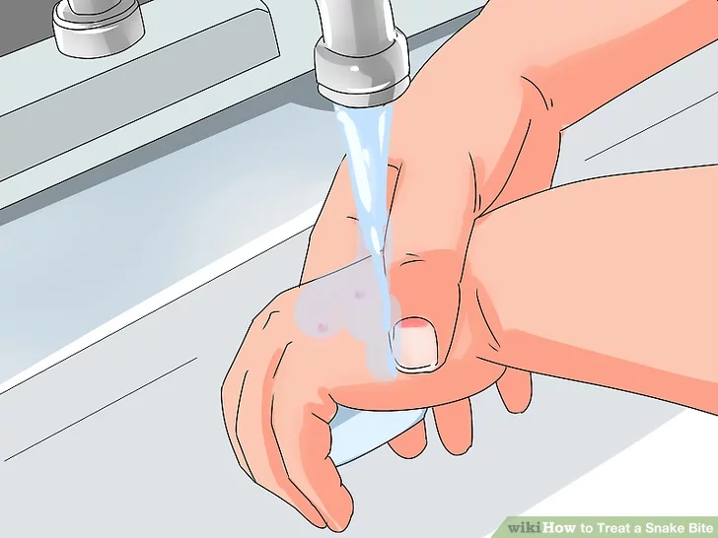
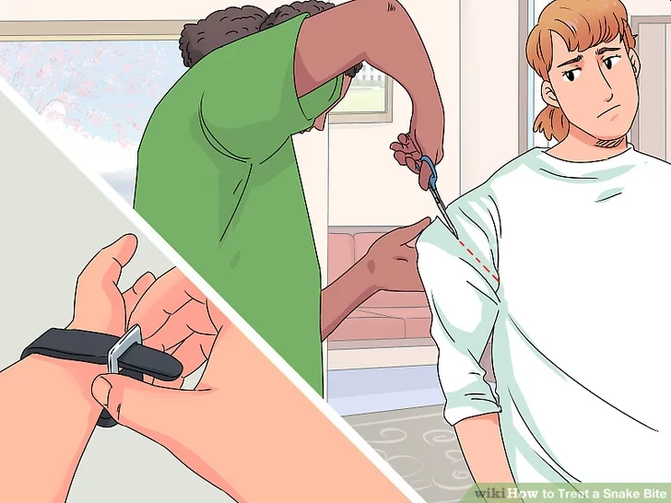
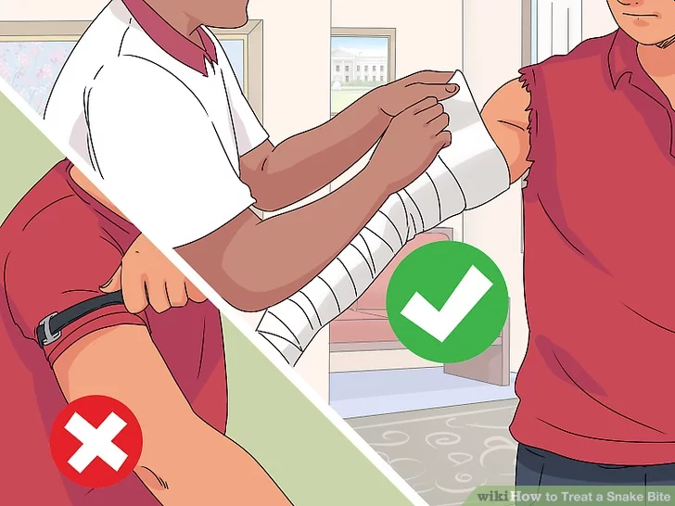
First Aid for Poisonous Snake Bites
Have victim lie down and stay calm.
Keep bitten area immobile and below level of heart.
Call 911.
Wash bite wound with soap and water.
Remove jewelry or tight clothing before swelling.
Do not try to catch snake but note appearance.
If possible, wrap entire extremity with elastic (compression) bandage to slow spread of venom.
Do not use a tourniquet.
Do not cut wound open to try to drain or suck venom out.

Slide 36

Requirement 2
Explain what orienteering is.

Slide 37
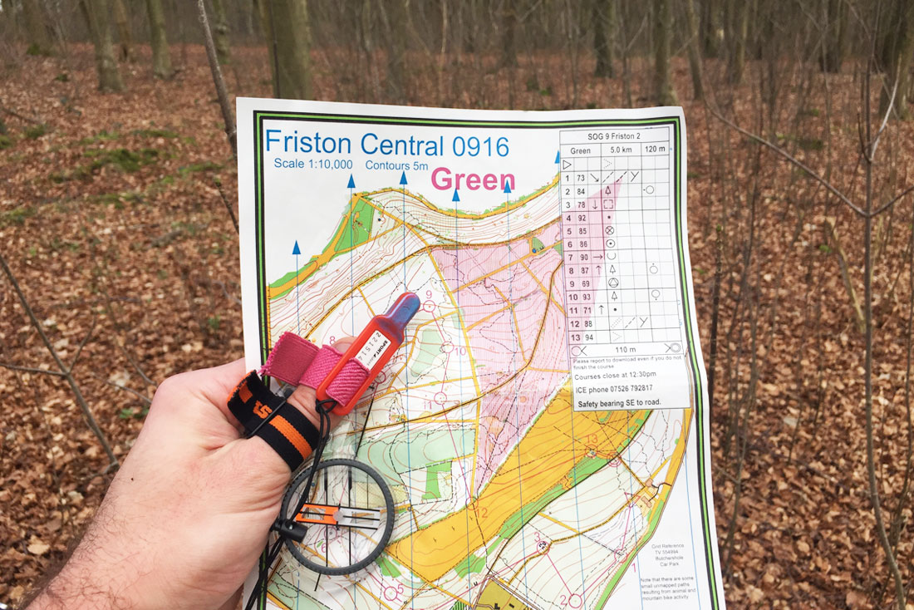
What Is Orienteering
Orienteering is a cross-country race in which participants use a highly detailed map and a compass to navigate their way between checkpoints along an unfamiliar course.

Slide 38

Requirement 3
Do the following:
  Explain how a compass works. Describe the features of an orienteering compass.
  In the field, show how to take a compass bearing and follow it.

Slide 39
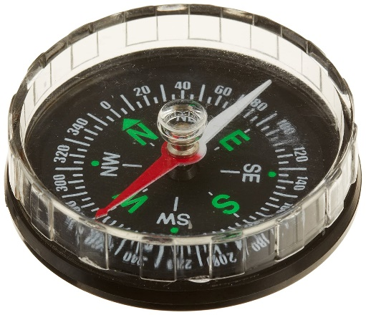
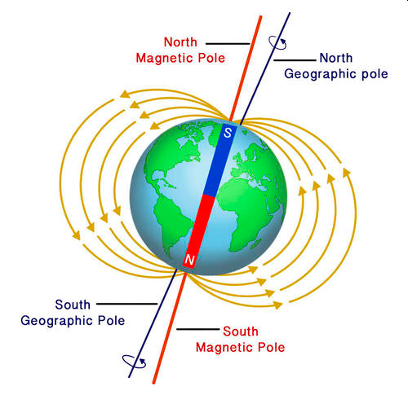
How a Compass Works
A magnetic compass consists of a small, lightweight magnet balanced on a nearly frictionless pivot point so it can turn easily.
The magnet is generally called a needle and one end of the needle is often marked "N," for north, or colored in some way to indicate that it points toward north.
It functions as a pointer to "magnetic north“ because the magnetized needle at its heart aligns itself with the Earth's magnetic field.
The magnetic field exerts a force on the needle, pulling the North end of the needle approximately toward the Earth's North magnetic pole, and pulling the other toward the Earth's South magnetic pole.
When the compass is held level, the needle turns until, after a few seconds to allow oscillations to die out, it settles into its equilibrium orientation.

Slide 40
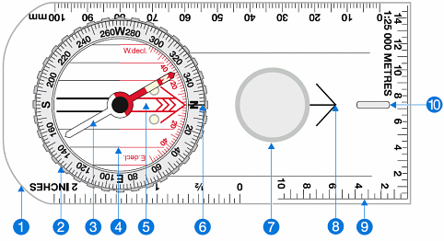
Orienteering Compass
The base plate mounting of the compass, with a ruler for measuring scale.
The compass housing contains the magnetic needle and has the points of the compass printed on a circular, rotating bezel.
The compass needle floats on liquid so it can rotate freely, the red end should always point to magnetic north.
Orienting lines fixed within the compass housing and designed to be aligned with the vertical grid lines on a map. Half the lines are colored red to indicate north.
Orienting arrow fixed within the compass housing, aligned to north on the housing.
The index line fixed within the outer edge of the compass housing as an extension of the direction of travel arrow. It marks the bearing you set by rotating the compass housing.
Magnifier for detailed map reading.
The direction of travel arrow shows the direction that you want to travel along or the bearing you are taking. It is fixed parallel to the sides of the base plate and aligned with the fixed index line on the edge of the compass housing (number 6).
Compass scale displayed along the edge of the base plate so you can measure distances on maps.
Luminous strip to assist navigation at night.

Slide 41
Requirement 3
Do the following:
  Explain how a compass works. Describe the features of an orienteering compass.
  In the field, show how to take a compass bearing and follow it.

Slide 42
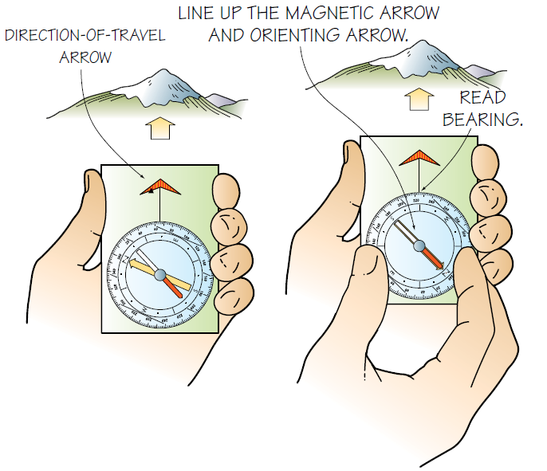
Compass Bearings
Taking a bearing is simply measuring a direction from one point on the ground to another.
Hold the compass in one hand, centered on your body.
Rotate your body and the compass until the direction-of travel arrow points in the direction you want to go.
Rotate the bezel of the compass until the north end of the magnetic arrow (usually red) lines up with the north end of the orienting arrow.
Determine the bearing by reading the number on the bezel directly opposite the bearing index.

Slide 43

Requirement 4
Do the following:
  Explain how a topographic map shows terrain features. Point out and name five terrain features on a map and in the field.
  Point out and name 10 symbols on a topographic map.
  Explain the meaning of declination. Tell why you must consider declination when using map and compass together.
  Show a topographic map with magnetic north-south lines.
  Show how to measure distances using an orienteering compass.
  Show how to orient a map using a compass.

Slide 44
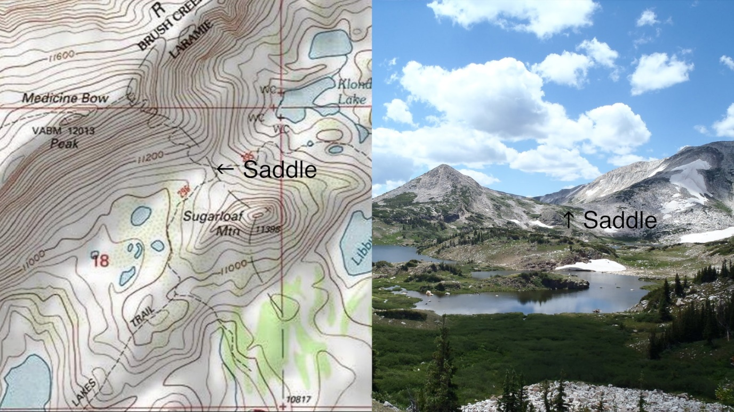
Topographic Maps
Topographic maps are generally large-scale maps that depict both the physical and man-made features of the landscape; and are distinctly characterized by the presence of contour lines that show the in-detail ground relief of the land.
Contour lines allow you to visualize the 3D world on a 2D map and identify specific features of the landscape, such as valleys, ridges, slopes, mountains, hills and spurs.

Slide 45
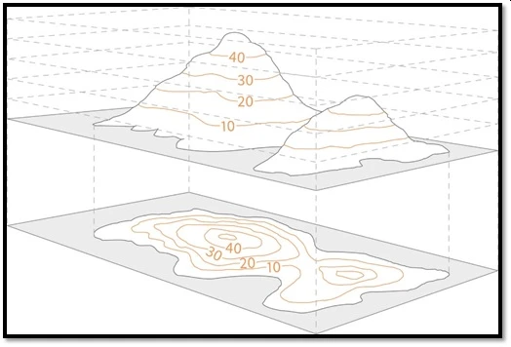
Topographic Maps
How contour lines show a pair of small hills
A Contour line is a line on a map that joins points of equal height above sea level, allowing for an easy visual representation of the height of mountains, steepness of slopes and the general sense of the terrain.
The shape of the contour lines is an important piece of information that allows you to identify features on the map such as peaks, ridges, saddles or valleys.

Slide 46
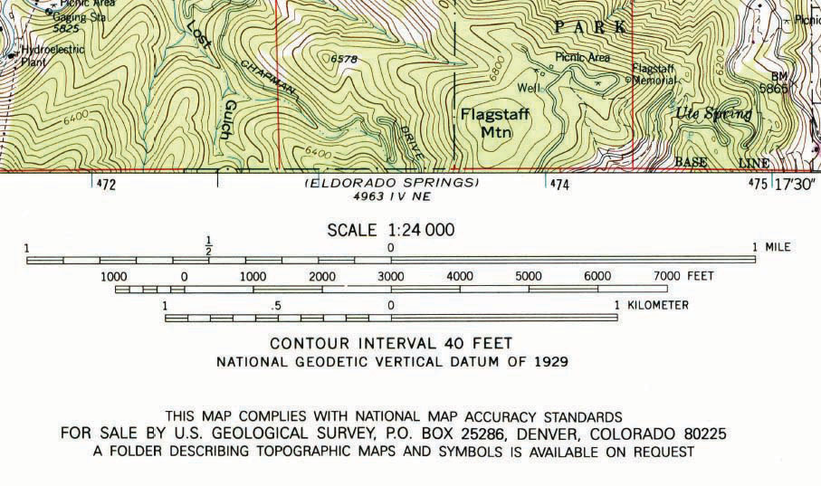
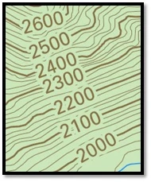
Topographic Maps
Contour lines have set intervals depending on the scale of the map.
Contour intervals indicate the change in elevation from one contour line to the next.
The contour interval for most USGS maps is 20 or 40 feet, while for most orienteering maps it is 3 or 5 meters.
The contour interval will usually be stated in the map legend.
Not every contour line is labeled, on most Topographic maps only every fifth contour line is labeled, these are known as Index Contours, and are indicated on the map by being bolder than the other contours.

Slide 47
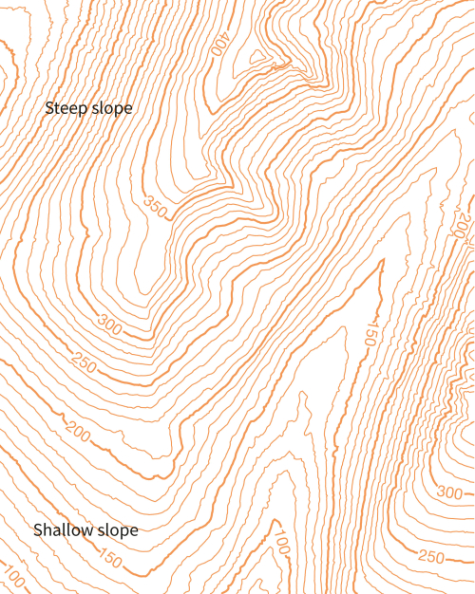
Topographic Map Terrain Features
Slope steepness and rapid elevation changes are indicated by how close the contour lines are to one another; the steeper the slope the closer the contour lines will be together.

Slide 48
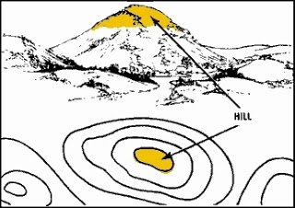
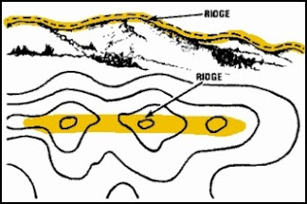
Topographic Map Terrain Features
Hill or Mountain Summit - a point or small area of high ground. When you are on a hilltop or mountain, the ground slopes down in all directions.
Ridge - a line of high ground with height variations along its crest. The ridge is not simply a line of hills; all points of the ridge crest are higher than the ground on both sides of the ridge.

Slide 49


Topographic Map Terrain Features
Valley - reasonably level ground bordered on the sides by higher ground. A valley may or may not contain a stream course. A valley generally has maneuver room within its confines. Contour lines indicating a valley are V-shaped and tend to parallel a stream before crossing it. The point of the V where the contour line crosses the stream always points upstream.
Saddle - a dip or low point along the crest of a ridge. A saddle is not necessarily the lower ground between two hilltops; it may be a break along an otherwise level ridge crest.

Slide 50


Topographic Map Terrain Features
Depression - a low point or hole in the ground, surrounded on all sides by higher ground.
Draw - similar to a valley, except that it normally is a less developed stream course in which there is generally no level ground and, therefore, little or no maneuver room. The ground slopes upward on each side and toward the head of the draw. The point of the V where the contour line crosses the draw always points uphill.

Slide 51


Topographic Map Terrain Features
Spur - a usually short, continuously sloping line of higher ground, normally jutting out from the side of a ridge. A spur is often formed by two parallel streams cutting draws down the side of a ridge. Contour lines indicating a spur are usually U-shaped. The bottom of the U always points downhill.
Cliff - a vertical or near-vertical slope. A cliff may be shown on a map by contour lines being close together, touching, or by a ticked "carrying" contour line. The ticks always point toward lower ground.

Slide 52
Requirement 4
Do the following:
  Explain how a topographic map shows terrain features. Point out and name five terrain features on a map and in the field.
  Point out and name 10 symbols on a topographic map.
  Explain the meaning of declination. Tell why you must consider declination when using map and compass together.
  Show a topographic map with magnetic north-south lines.
  Show how to measure distances using an orienteering compass.
  Show how to orient a map using a compass.

Slide 53
Topographic Map Symbols
In general these are the major color categories used on USGS topo maps.
Brown lines – contours (note that intervals vary)
Black lines – roads, railroads, trails, and boundaries
Red lines – survey lines (township, range, and section lines)
Blue areas – streams and solid is for larger bodies of water
Green areas – vegetation, typically trees or dense foliage
Pink or light gray areas – cities and dense buildings (“built-up areas”)
Purple areas – used to show what was new on the latest editions of their maps (USGS no longer does this but it is still on some maps)

Slide 54

Topographic Map Symbols
Download the Topo Map Symbols and the Topo Map Symbols Flash Cards to practice and become proficient in identifying topographical map symbols.

Slide 55
Requirement 4
Do the following:
  Explain how a topographic map shows terrain features. Point out and name five terrain features on a map and in the field.
  Point out and name 10 symbols on a topographic map.
  Explain the meaning of declination. Tell why you must consider declination when using map and compass together.
  Show a topographic map with magnetic north-south lines.
  Show how to measure distances using an orienteering compass.
  Show how to orient a map using a compass.

Slide 56

Declination
To understand declination you must first realize that there are two North Poles.
There is a True Geographic North Pole at the top of the world, and a Magnetic North Pole.
A compass points to Magnetic North, not True North.
Magnetic declination refers to the angle between the geographic North Pole and the magnetic pole located in the Arctic Ocean.

Slide 57
Declination
Which North to Use
There are two types of north to contend with.
When you look at your map, it is drawn in relation to true north; when you look at your compass, it points to magnetic north.
To make the map and compass work together you must decide on one North as your point of reference and base all your calculations on that.
As you can see the following chart, failure to take declination into account can put you way off target.
Declination or Degrees Off Course | Error Off Target after Walking 10 Miles
1° | 920 feet (280 meters)
5° | 4,600 feet (1,402 meters)
10° | 9,170 feet (2,795 meters)

Slide 58

Declination
What's your Map Declination?
The first thing you need to know is where you are in relation to magnetic north.
You can find this information by looking on your map legend.

Slide 59

Declination
If you look at the map of North America, you will see the line roughly marking 0° declination.
If you are on the line where the declination is 0°, then you don't have to worry about any of this, since magnetic north and map north are equivalent.
If you are to the right of that line, your compass will point toward the line (to the left) and hence the declination is to the west.
If you are to the left of the line, your compass will point toward the line (to the right) and hence the declination is to the east.

Slide 60
Requirement 4
Do the following:
  Explain how a topographic map shows terrain features. Point out and name five terrain features on a map and in the field.
  Point out and name 10 symbols on a topographic map.
  Explain the meaning of declination. Tell why you must consider declination when using map and compass together.
  Show a topographic map with magnetic north-south lines.
  Show how to measure distances using an orienteering compass.
  Show how to orient a map using a compass.

Slide 61

Magnetic North-South Lines
If you do not compensate for declination, you will not be able to find the actual direction between two points as related to the north and south of the landscape.
The simplest solution is to convert the language of the map into the language of the compass.
Do this by drawing magnetic north-south lines on the map by lining up a ruler against the magnetic north arrow and extending this line with a pencil to the top of the map.
Draw parallel lines to this one, a ruler’s width apart.
This has already been done on all orienteering maps.

Slide 62

Orienteering Map with Magnetic North Lines

Slide 63
Requirement 4
Do the following:
  Explain how a topographic map shows terrain features. Point out and name five terrain features on a map and in the field.
  Point out and name 10 symbols on a topographic map.
  Explain the meaning of declination. Tell why you must consider declination when using map and compass together.
  Show a topographic map with magnetic north-south lines.
  Show how to measure distances using an orienteering compass.
  Show how to orient a map using a compass.

Slide 64


Measuring Distance with a Compass
Measuring Distance on a Map
Depending on the type of compass, a variety of scales may be marked along the edge of the baseplate. Ideally, one scale on the compass is the same as that on your map. For example, if your map has a scale of 1:24,000 and your compass has that scale on its baseplate, measuring distance is simple. Take the edge of the compass with the proper scale on it and connect the points for which the distance is desired. Simply read the distance directly from the scale. It is fairly common to find orienteering compasses with scales of 1:15,000 or 1:24,000.

Slide 65

Measuring Distance with a Compass
Measuring Distance on a Map
Sometimes you might want to use the edge of the compass as a ruler, with inches on one side and millimeters on the other side of the baseplate. Measure the distance on the map with either scale and compare those distances with the distance rulers on the margin of the map. Read off the ground distance. Distance rulers on maps are generally in miles, kilometers, and feet. Orienteering uses metric measurements, so you usually will use the kilometer/meter distance bar on the map.

Slide 66

Requirement 4
Do the following:
  Explain how a topographic map shows terrain features. Point out and name five terrain features on a map and in the field.
  Point out and name 10 symbols on a topographic map.
  Explain the meaning of declination. Tell why you must consider declination when using map and compass together.
  Show a topographic map with magnetic north-south lines.
  Show how to measure distances using an orienteering compass.
  Show how to orient a map using a compass.

Slide 67
How to Orient a Map
Orienting a map means aligning it with the terrain.
An accurate way of aligning the map and terrain is to use a compass.
First, rotate the compass bezel until N or 360 degrees is lined up with the direction-of-travel arrow.
Next, set the compass down on the map, with the compass edge along one of the north-south magnetic lines and the direction-of-travel arrow pointing north.
Rotate the map and the compass until the compass needle matches the direction-of-travel arrow.
The map is now oriented.

Slide 68

Declination
If the magnetic north-south lines are not drawn on the map, convert the language of the compass to that of the map.
When you take a bearing from the map or apply it to the map, you must add or subtract the declination to the compass reading depending on whether the declination is easterly or westerly.
Always add the number of degrees of error for west declination and subtract for east declination.

Slide 69
Requirement 5
Set up a 100-meter pace course. Determine your walking and running pace for 100 meters. Tell why it is important to pace-count.

Slide 70

Judging Distance
For some people, judging distance is the hardest part of orienteering.
One way of judging distance is by Pace-Counting or counting every time your right (or left) foot touches the ground over a given distance.
Another method is to calculate the time it takes you to cover a predetermined distance.
A standard length course for taking these measurements is 100 meters.

Slide 71

Pace Measuring Course
Setting Up a 100-Meter Pace-Measuring Course
  Lay out a 100-meter course in a straight line using a tape measure.
  Clearly mark the beginning and the end of the course.
Walking Pace/Time
  Once you have laid out the course, start at the beginning and walk the length of it, counting the number of paces and recording the time it takes you to reach the end.
  This is your walking pace and time per 100 meters.
  You will get a more accurate measure if you walk the course two or more times and then divide the total paces and minutes by the total meters walked.
  This is particularly important if the course is on uneven ground.

Slide 72

Running Pace/Time
Running Pace/Time
  Foot speed is important in orienteering, especially for competitive orienteering.
  As your stride lengthens, the distance you cover increases.
  So the number of paces per 100 meters will decrease, as will the time it takes you to cover that distance.
  Measuring your running pace and time is exactly the same as measuring your walking pace.
  Because this is much more active, it is even more important that you run the course several times to get a true measure.

Slide 73

Distance Computer
Download the handouts “How to Make Your Own Distance Computer” and “Distance Computer Image” to construct your own distance computer to help you easily calculate pacing and distances.

Slide 74

Requirement 6
Do the following:
  Identify 20 international control description symbols. Tell the meaning of each symbol.
  Show a control description sheet and explain the information provided.
  Explain the following terms and tell when you would use them: attack point, collecting feature, catching feature, aiming off, contouring, reading ahead, handrail, relocation, rough versus fine orienteering.

Slide 75

International Control Description Symbols

Slide 76

International Control Description Symbols

Slide 77

Requirement 6
Do the following:
  Identify 20 international control description symbols. Tell the meaning of each symbol.
  Show a control description sheet and explain the information provided.
  Explain the following terms and tell when you would use them: attack point, collecting feature, catching feature, aiming off, contouring, reading ahead, handrail, relocation, rough versus fine orienteering.

Slide 78

Control Description Sheet
Download the Orienteering Control Descriptions, Orienteering Control Practice Sheets, and the Orienteering control Answers.
Use them to practice and become proficient in utilizing the information provided by control description sheets.
Sample Control Description Sheet

Slide 79
Requirement 6
Do the following:
  Identify 20 international control description symbols. Tell the meaning of each symbol.
  Show a control description sheet and explain the information provided.
  Explain the following terms and tell when you would use them: attack point, collecting feature, catching feature, aiming off, contouring, reading ahead, handrail, relocation, rough versus fine orienteering.

Slide 80

Handrail
Handrails are linear features along the leg of a course that lead you in the direction you want to go and provide easier travel, continuous direction, and a more accurate position.
Orienteers’ handrails can be either natural or artificial features such as streams, trails, roads, fences, and power lines.
More obscure handrails might be ridge lines, valleys, tree lines, forest fire burns, or avalanche scars.
In this illustration, the orienteer follows the pipeline handrail almost directly to the
control location.

Slide 81

Attack Point
An Attack Point is a large, easily recognized feature that is near the control.
The attack point helps you determine your exact location and reach the control.
From the attack point, you can use precise navigation, such as an accurate bearing and pace counting, to carefully zero in on the control.
For example, you might use a large vegetation boundary, a path junction, or a hill top as your attack point before going on to find a knoll or a boulder.
The trail bends provide the most obvious attack points

Slide 82

Catching Feature
A Catching Feature is a broad and easily identifiable feature, typically linear and perpendicular to your path of travel, that will “catch” you like a baseball backstop in case you go too far.
Good catching features are distinct trails or roads, distinct ridges or valleys, distinct rivers, and really anything that is linear in shape and distinct enough that you won’t miss it.

Slide 83

Collecting Feature
A Collecting Feature is a large, easy-to-find feature between your current location and the control.
There may be some obvious features along the route, such as a large pond or small lake, that will help send you in the right direction.

Slide 84

Aiming Off
Aiming Off means deliberately aiming to one side of a feature on or near to confidently predict which side it will appear on.
In this map, it would be easy to reach the road and not be sure what direction the control lies.
To prevent this, you can deliberately aim a few meters south of the control so you know to turn north when you get to the road.
You are hedging your bets by purposely being inaccurate to eliminate one side of the checkpoint.

Slide 85

Contouring
Following the contour line is called Contouring, and it is often the most efficient path of travel between two points in rough terrain.
In this example, a person who is contouring would follow a route that is level or downhill.
The direct route would mean a climb of 10 to 15 meters (33 to 50 feet).
Although the distance to contour is greater, the effort expended is less.

Slide 86
Reading Ahead
Keep a clear mental picture of the terrain that you will pass through.
Read the map every few seconds, think beyond your location, and plan ahead.
The best way to practice reading ahead is to take time at the beginning of the course and after each control to make sure you understand what the map is telling you.
Do not move until you are sure.
It is just as important to keep oriented every moment while you are traveling and to keep an eye on what lies ahead. Keep your map out and refer to it often.
Make sure that what you are seeing on the ground matches what the map tells you should be there.
If you find this is not the case, then either you are reading the map wrong or you have strayed from your intended course.

Slide 87

Relocation
If you don’t know where you are, stop and Relocate.
Find a definite feature that you can correctly locate.
In this example, the control location is the lower end of an intermittent stream shown by the circle. When you arrive at where you think it should be, you can’t find the control bag. You could be at any of the stream ends marked by the small X’s. Which way should you go? The large impassable cliff or the long earthen bank shown by the arrows would be impossible to miss. To pinpoint your location, go west along the shoreline until you encounter one of these. Moving to a known position is always a better choice than aimless searching.

Slide 88
Rough vs. Fine Orienteering
The search for the next control point in an orienteering problem often can be divided into the rough orienteering phase and the fine orienteering phase.
In Rough Orienteering, you are moving in broadly defined directions toward a collection point found on the map. This is the time for covering a lot of ground quickly. You will not be in danger of missing the control during this phase because the control will not be close at hand.
Once you reach the chosen collection point, it is time to switch to Fine Orienteering. Locate yourself precisely, and determine where you are in relation to the control. Form a plan that will accurately lead you to the control. This may involve using handrails, attack points, and compass bearings. Remember that in this phase accuracy is the primary goal.

Slide 89
Route Choice
Steps in Choosing a Route
Note the exact location of the control on the map and read its description from the description sheet.
Choose an attack point (if the control is not placed in an obvious position) very close to a feature that you can easily recognize—a bridge, a trail junction, power lines over a path, a corner of a forest.
Look at the direct route from your present position to the attack point. See whether it will be easy to follow on a compass bearing.
Look to the left and right of the direct route and see whether there is an easier and quicker route. An indirect route may require less hill climbing or pushing through dense woods.
Take the fastest route to the attack point.
Run as fast as possible to the attack point, using collecting features to find the way.
Take an accurate compass bearing (if necessary) from the attack point to the control.
Measure the exact distance on the map from the attack point to the control.
Walk or jog accurately on a compass bearing, counting the paces until you find the control.

Slide 90

Requirement 7
Do the following:
  Take part in three orienteering events. One of these must be a cross-country course.
  After each event, write a report with:
    a copy of the master map and control description sheet ,
    a copy of the route you took on the course,
    a discussion of how you could improve your time between control points, and
    a list of your major weaknesses on this course . Describe what you could do to improve.

Slide 91

Orienteering Events
Orienteering USA is the national governing body for orienteering in the United States.
Click on the following link to Find Your Closest Club.
Many of these clubs operate over a large area so be sure to check out their calendar for the closest events!

Slide 92
Requirement 7
Do the following:
  Take part in three orienteering events. One of these must be a cross-country course.
  After each event, write a report with:
    a copy of the master map and control description sheet ,
    a copy of the route you took on the course,
    a discussion of how you could improve your time between control points, and
    a list of your major weaknesses on this course . Describe what you could do to improve.

Slide 93
Orienteering Event Report
Download the Orienteering Merit Badge Workbook for help in filling out these reports

Slide 94
Requirement 8
Do ONE of the following:
  Set up a cross-country course of at least 2,000 meters long with at least five control markers. Prepare the master map and control description sheet.
  Set up a score-orienteering course with 12 control points and a time limit of at least 60 minutes. Prepare the master map and control description sheet.

Slide 95

Cross Country Orienteering
In Cross-Country Orienteering, every competitor must visit the same controls in numerical order, and as quickly as possible.
This form of orienteering is a challenge in route choice and stamina.
Controls, usually eight to 24, will be marked on competitors’ maps with numbered circles.
All features where controls are placed will be clearly described on a control description sheet that each competitor gets along with the map.
Each control will have a unique code letter or number.
If the competitor does not find all his checkpoints, he is disqualified.
There is usually a 3-hour time limit.
The winner is the fastest competitor who has all the correct control punches.

Slide 96
Requirement 8
Do ONE of the following:
  Set up a cross-country course of at least 2,000 meters long with at least five control markers. Prepare the master map and control description sheet.
  Set up a score-orienteering course with 12 control points and a time limit of at least 60 minutes. Prepare the master map and control description sheet.

Slide 97

Score-Orienteering
In Score Orienteering Competitions, many controls, or checkpoints, are placed in an area of 1 to 2 kilometers around the starting point, which is also the finish line.
The number of controls may vary.
Each one has a point value.
Controls that are farthest from the start or hardest to find are awarded a higher point value; those near the start and easy to find get lower values.
Competitors have a set time to find as many controls as they can and earn as large a point total as possible.
They may visit the controls in any order they wish.
The course is designed so that they cannot possibly find all the controls in the time allowed.
A penalty of 1 point is subtracted from a competitor’s total for every 10 seconds he is overdue at the finish.
In team events, this penalty can be changed to 5 points for every minute late.
The highest score wins.

Slide 98
Setting Up an Orienteering Course
Location
The framework of all orienteering courses is the competition site and its map.
Each must be considered before any detailed planning of an orienteering event is possible.
Find an area that has an existing map, or make a map of the area yourself.
Area With an Existing Map
Because of the increasing popularity of the sport of orienteering, more and more maps designed specifically for orienteering are available.
If you plan to run a competition in your area, it would be worthwhile to ask local orienteering groups whether maps are available of the area you intend to use.

Slide 99

Setting Up an Orienteering Course
Area Without an Existing Map
The easiest low-tech way to create a course map is to take an existing map, such as a USGS topographic map, and add more detail to it.
This detail should include International Orienteering Federation (IOF) symbols, IOF terminology, orienteering vegetation colors, and magnetic north lines.
One way of converting a USGS topographic map is to lay tracing paper or clear plastic over the old map, tracing what you want from the old map and adding detail specific to orienteering.

Slide 100
Setting Up an Orienteering Course
You are now ready to begin creating a course map.
Standing at the start (which you should mark so that you can return to it easily), take a compass bearing to the first point.
Plot this bearing onto the paper by placing the edge of the compass on the X and rotating the compass until the orienting arrow or the north-south lines of the compass are parallel to the magnetic north lines on the paper.
Using the edge of the compass, draw a line onto the paper. The point lies somewhere along this line. To determine where, walk to it as you count your paces. If you have practiced counting your paces, you will be able to figure how far the point is and place it accurately onto your line. Put a small X here. You will take the next bearing from this point.

Slide 101

Setting Up an Orienteering Course
This process provides only a “stick figure” map. Add detail along the bearing lines by noting and sketching in natural and artificial features as you move along. You can reach a fair level of accuracy by pacing off distances and taking rough compass bearings. To locate a feature more precisely, take a bearing on it from two known points on the route. The feature is located at the intersection of the two bearings.

Slide 102


Setting Up an Orienteering Course
Walk around the intended course taking bearings and plotting them onto the map until you return either to the starting point or to a separate finish. You now have a rough field map of the area. Tidy it up and add as much detail as you like. Particularly important are a scale relating distance to pace and a magnetic north arrow. You can add symbols for certain terrain features and color to show vegetation. Make sure you explain the symbols and colors in a map legend. Date your map, as features change with time. Give it a name, and put your name on it as mapmaker.

Slide 103

Setting Up an Orienteering Course
Once you have the area map in hand, whether it be a preexisting one or one you have made, copy individual maps for each contestant

Slide 104
Setting Up an Orienteering Course
Competition Site
  Besides the course, the location for your orienteering event will require a meeting place for contestants, officials, and spectators, and reporting to race officials for the send-off and finish.
Assembly Area
  The assembly area is a gathering place for the participants and race officials and also may be where a first-aid station is located. This area should include adequate parking, bicycle racks, changing rooms, and bathrooms. If changing rooms and bathrooms are not available at the site, the participants should be told of this before the race. Shelters can help keep participants and spectators comfortable during inclement or hot weather. These may exist on-site, or you may erect temporary ones. Orienteers gather here to register and receive instructions, maps, control description sheets, control cards, starting times, and numbers or numbered bibs. This is also where competitors study their maps and fill out control cards before moving on to the start.

Slide 105
Setting Up an Orienteering Course
Finish
  The finish can be at the same place as the start, slightly removed, or in an entirely different place. It is better to separate the finish and the start by a short distance to ease congestion and confusion. When an orienteer reaches the finish, the timer records his finish time on his control card. The timer then passes the card to the recorder, who grades and records the result on the recorder’s sheet. The orienteer’s standing is determined and posted on the results board. The orienteer can then take a few minutes to catch his breath, cool down, and get some refreshments. Have at least water available at the site, but juice or sports drinks and fruit, such as oranges and bananas, are welcome. If there is a possibility of inclement weather, it is a good idea to have a place, such as a large tent, where competitors can get out of the rain or wind.

Slide 106
Setting Up an Orienteering Course
Course Setting
Try to produce a course that will challenge but not discourage the competitors. Do not overestimate the ability of the competitors who will run the course. It is better to make a course too easy than too hard. A competitor may not return to the sport after an initial negative experience. Consider these things:
Design the course to fit the area you have available.
Determine the amount of time available for the event. This will give you an idea of the number of control points the course will have.
For beginners, the course should not be very complicated. Do not give them too many choices.
Avoid dangerous areas such as swift streams, highway crossings, swamps, and utility facilities. When these areas are present, competitors must be well aware of their existence. You can inform competitors by noting these features prominently on the individual maps or by having a briefing before the competition.
The course may cross private property only when permission has been obtained from the landowner. Off-limit and private areas should be noted on all maps.

Slide 107
Setting Up an Orienteering Course
Selecting the Controls
  Pick out the “problem” controls (areas that present more of a challenge to the orienteer), for example, whether to go over or around a hill. Plot controls for these key sections on the map. This basic course skeleton along with start and finish locations, the length of the course, and the number of controls will allow you to figure the general shape of the course. It is almost like connecting the dots to get a full picture.
Control Description Sheet
  Once you have decided where the controls will be, make a control description sheet for the course. Each contestant will be given one of these sheets at the start of the contest.
Checking the Course
  Rarely does the perfect course result from the first attempt. Because so many factors are considered as you set up a course, it is easy to overlook something. It might be best if several Scouts worked on the course together. Afterward, ask your counselor to check the course. This is called vetting the course.

Slide 108
Setting Up an Orienteering Course
Event Officials
  At least three officials will be needed at both the start and the finish. They may be the same people for both if the start and finish are at the same location. Their titles and duties are as follows.
At the Start
  The course organizer briefs orienteers in the assembly area, issues control cards and maps, and calls orienteers forward to start individually. The recorder writes the names and start times of every orienteer on the recorder’s sheet, checks each orienteer’s name and start number on the individual control cards, and issues last-minute instructions. The timer controls the master clock and releases the orienteers across the start line at their start time (usually 1 minute apart).
At the Finish
  The timer records the finish time of each orienteer on his control card and passes the card to the recorder. The recorder writes each orienteer’s finish times on the recorder’s sheet and tallies final scores based on times and correctness of control points visited. The course organizer verifies the correctness of names, finish times, and final scores; posts positions of orienteers on the results board; and accounts for all orienteers at the end of the event.

Slide 109
Requirement 9
Act as an official during an orienteering even. This may be during the running of the course you set up for requirement 8.

Slide 110
Requirement 10
Teach orienteering techniques to your patrol, troop or crew.

Slide 111

Edge Method
The EDGE Method
Explain – talk about what you will be doing and why it's important. ...
Demonstrate – Next, show them what the skill looks like when it's done correctly; you can talk about what you are doing as you go so they understand your actions. ...
Guide – Now it's their turn. ...
Enable – In the final step, they get to do it on their own.

